Slide 1


Analysis of Medical Imaging Errors and Their Improvements
CSA0504 – Computer Vision
Presented By:
Guided by:
Dr. P. Mathivanan
B. Pranay Deep Chowdary
(192472177)

Slide 2


Introduction to Medical Imaging Errors
Medical Imaging Errors
Medical imaging helps doctors diagnose diseases using X-rays, CT scans, MRI, Ultrasound, and PET scans.
Imaging errors occur when incorrectly identified, or misinterpreted.
These errors can lead to delayed diagnosis, wrong treatment, or unnecessary procedures.
Improving imaging accuracy is essential for patient safety and quality healthcare.

Slide 3
Case Study
Missed Lung Cancer Diagnosis
A 55-year-old patient visited the hospital with chest pain.
A chest X-ray was performed.
Due to poor image quality and radiologist workload, a small lung nodule was missed.
Six months later, the patient returned with severe symptoms.
A CT scan confirmed advanced-stage lung cancer.
Earlier detection could have improved treatment success and survival.

Slide 4


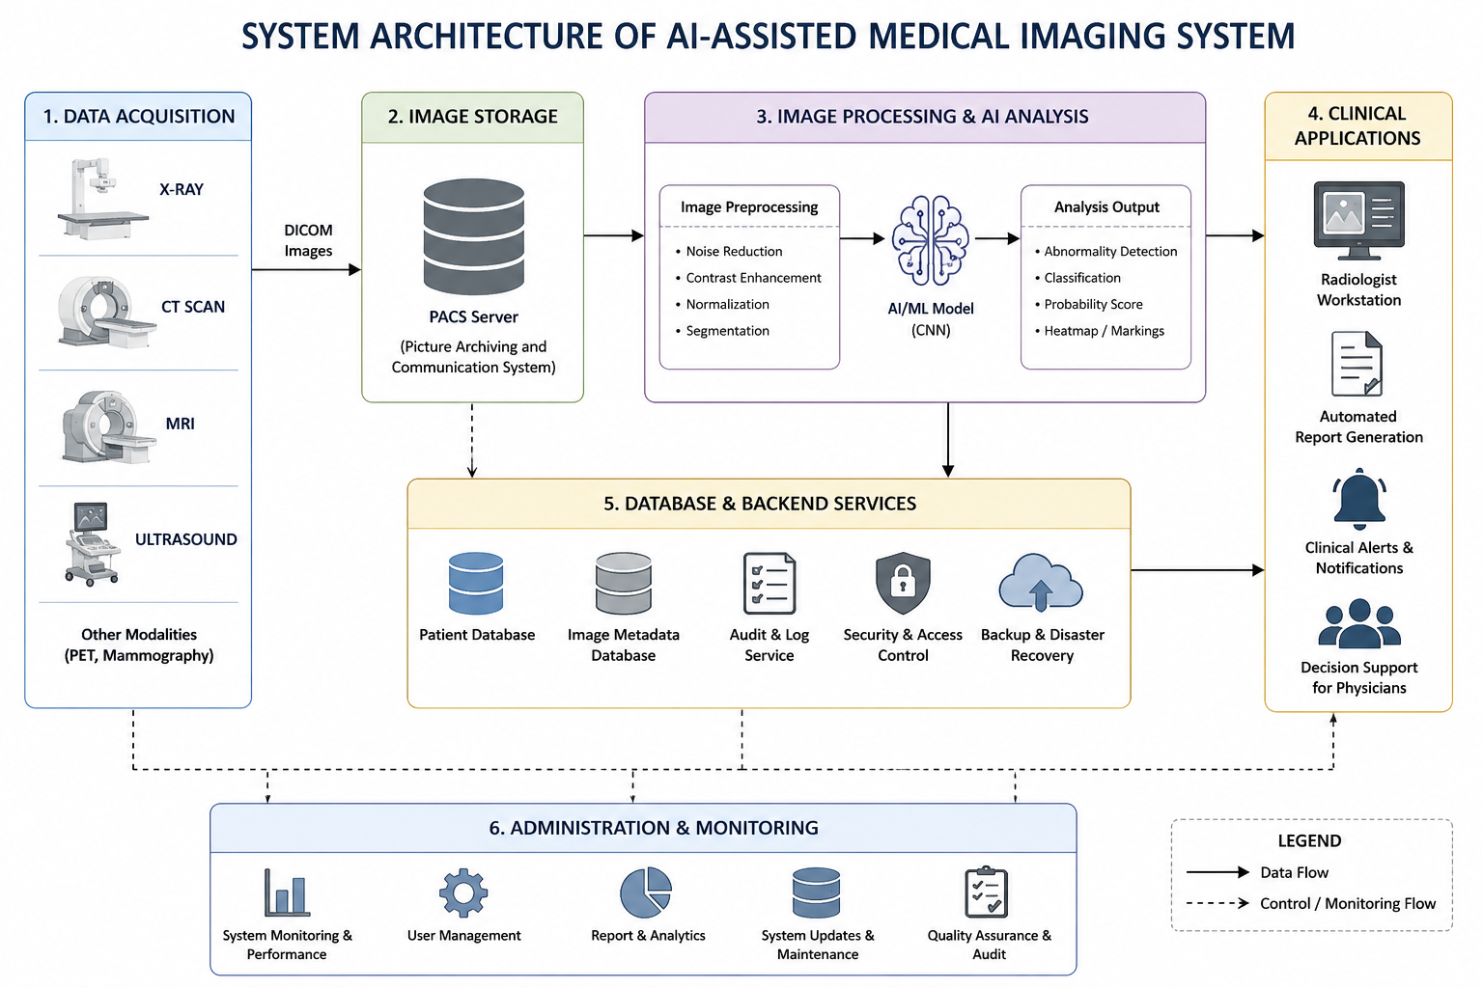
System Architecture

Slide 5
Causes of Medical Imaging Errors
Major Causes
Poor Image Quality: Low resolution, improper patient positioning, or equipment issues.
Human Error: Fatigue, inexperience, distraction, or heavy workload.
Communication Gaps: Incomplete patient history and poor coordination between doctors and radiologists.
Technical Problems: Outdated imaging equipment and improper calibration.
Single Image Review: Lack of a second opinion increases the risk of missed findings.

Slide 6
Improvements and Solutions
Reducing Imaging Errors
Use Artificial Intelligence (AI) to assist in detecting abnormalities.
Upgrade to high-resolution imaging equipment.
Implement double reading, where two radiologists review important scans.
Provide regular training for radiologists and technicians.
Improve communication between healthcare professionals.
Conduct quality assurance programs and routine equipment maintenance.

Slide 7
Benefits and Conclusion
Benefits of Improvements
Early and accurate disease detection.
Reduced diagnostic errors and misinterpretations.
Faster treatment and better patient outcomes.
Increased patient safety and confidence.
Lower healthcare costs by avoiding unnecessary procedures.
Conclusion
Medical imaging errors can significantly affect patient health. By combining advanced technology, AI support, skilled professionals, quality assurance, and effective communication, hospitals can minimize errors and provide safer, more accurate, and efficient healthcare services.

Slide 8
THANK YOU !

